Slide 1
Building a Home: Work of the living and work of the dead
Rabbi Lynn Greenhough

Slide 2
What is Magic? What is ritual?
A religious ritual is any repetitive and patterned behavior that is prescribed by or tied to a religious institution, belief, or custom, often with the intention of communicating with a deity or supernatural power.
The use of means (such as charms or spells) believed to have supernatural power over natural forces
Magic rites or incantations
An extraordinary power or influence seemingly from a supernatural source
Something that seems to cast a spell : enchantment
Imitative magic and contagious magic

Slide 3
Shedim: שֵׁדִים; singular: שֵׁד Sheyd) are spirits or demons in Tanakh and Jewish mythology.
Shedim are said to have had the feet and claws of a rooster. To see if the shedim were present, ashes were thrown to the ground or floor, which rendered their footsteps visible.
They can cause sickness and misfortune, follow the dead and fly around graves.

Slide 4
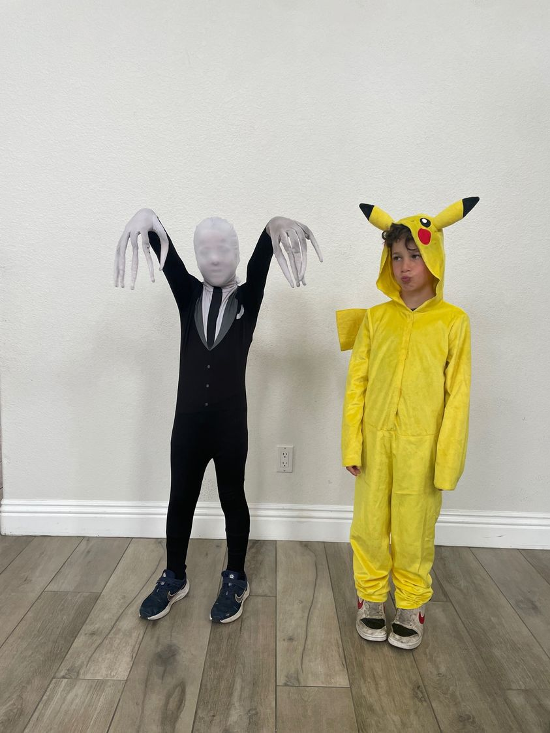

Slide 5
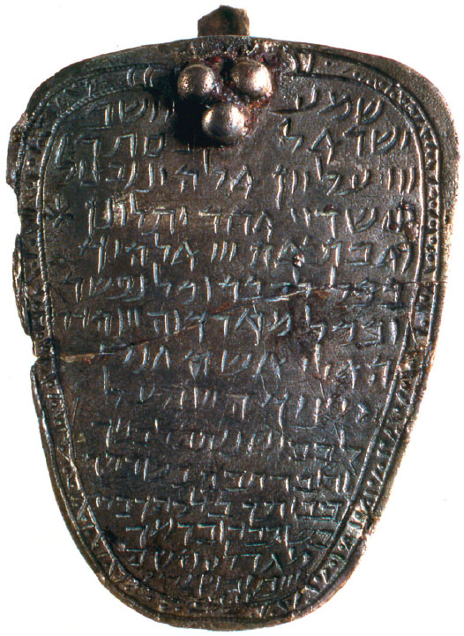
Sh’ma and Psalm 91: Funerals

Slide 6
Necromancy, talking to the dead is forbidden in Torah: Saul and the witch of Endor
The Torah takes a very negative attitude towards
witchcraft in its various formats, such as:
"A sorcerer shall not be allowed to live."
(Exodus 22:17)
"For you are coming into a land that God is granting
to you; do not learn the ways of the abominations
of the native people. There shall not be found
amongst you ... a sorcerer, soothsayer or engager
of witchcraft ... or one who calls up the dead.
For it is an abomination before God, and it is on
account of these abominations that God is giving
you their land." (Deut. 18:9-12)

Slide 7
Liminality = birth and death = Protection

Slide 8
Communication and protection: Liminality between living and dead

Slide 9
Necromancy continues to be forbidden in books of Nevi’im, Prophets
Summoning the dead from beyond is forbidden over and over.
Clearly this was a practice, or it would be mentioned so frequently.
A desire for communication between living and dead.
How will we see this desire for communication articulated?

Slide 10
Customs, rituals, demons

Slide 11
Understanding function/ritual
Recitation of Kaddish
Recited at burials by 7th or 8th centuries
Merit of one who recited Kaddish was transferred to the account of the one for whom Kaddish was being said
Ensure release from a longer stay in Gehinnom
Avoid reciting beyond 11 months
1400: recite Kaddish on yartzeit
Backdrop of demonology informed many earlier rituals
Rituals acted to counter strength of various demons
Shomrim: defend against evil spirits
Demons rendered ineffectual through constant prayer, mitzvot, tzedakah
Candles lit to protect souls of dead
Spirits could attack moving objects: those carrying bier would halt frequently, setting bier on ground

Slide 12
How did our burial practices evolve to provide both protection and communication – and stay within requirements of religious rites?

Slide 13
Diogenes: Throw me over the wall…

Slide 14
A home provides the dead with a recognizable place of intercession with the living.

Slide 15
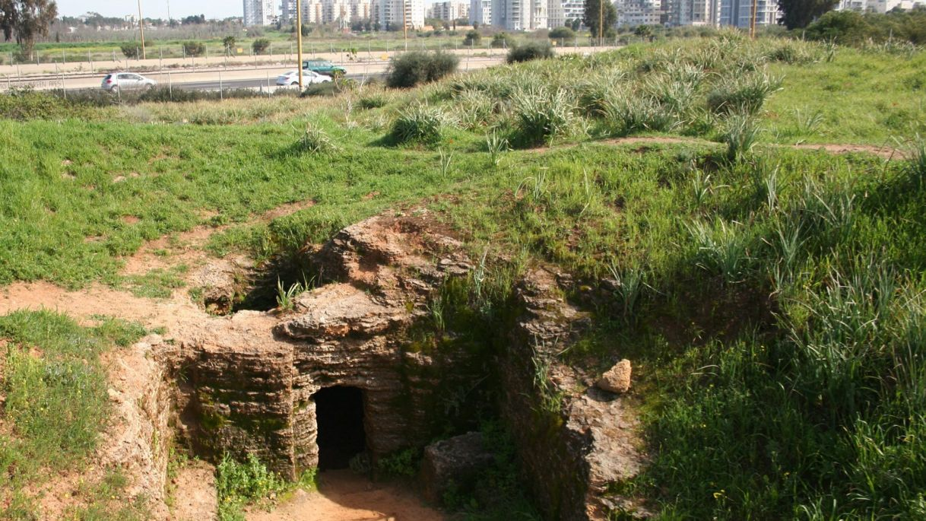
Travel: An ancient burial cave, dating from the 5th century BCE, next to one of Israel's busiest arteries, the Ayalon Highway.

Slide 16
For millennia we have built homes – for the living but also for the dead

Slide 17
Rachel Hallote: Death, Burial and Afterlife in the Biblical World
Archeology: Who gets buried, where and how, is the main window into a group’s culture
Social hierarchies
Differentiations – age, gender, health, wealth
Burials often leave a trace – tombs, pits, status of decedent
Interpretation of function: Burial locations reflect not so much economic or social status, but the role the deceased plays in the society after death
The dead can function to be guardians of fallow fields – where are the borders, how is such land protected?
Dead as shomrim, guardians
Guarding the land is an explanation for why burials were often placed far from cities. Still common in the Talmudic period
Eventually, we see a transition to shaft and chamber tombs, to house multiple family members.

Slide 18
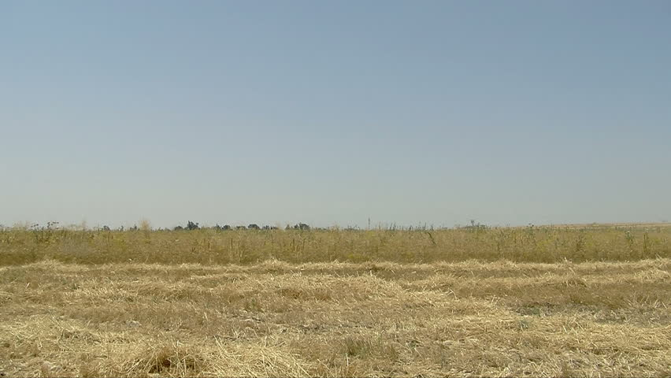
Cannanite era: Burials in floorboards, walls and fields: Dead as shomrim, guardians of families

Slide 19
Tombs, burials under and within houses
Burial under floorboards of houses were in use: keep them close
Reflects role of deceased in life as well as after death
Comfort in presence: Sites would probably be visible
Infant jar burials
Tomb as a womb for infants = Jar/house evolves to a tomb/house for adults.
Ian Hodder: tombs correspond in shape, construction, orientation, decoration, position of entrance to houses of same period.

Slide 20
Tomb as house
Cave of Machpelah – almost certainly a shaft and chamber complex
No single word in Hebrew – or English – distinguishes between carved caves and natural caves.
By Iron Age in Israel, tombs are very regular in shape – regular carved tombs called arcasolia
Housed family groups – usually with a central courtyard similar to houses of day

Slide 21
Cemeteries: Cities of the dead
Cemeteries grew organically – according to need rather than any pre-planning of size requirements
“Asaf” – gathering in of a person to their ancestors
Metaphorical or actual reference?
Family tombs – Israelite custom of moving older interments to make room for newer.
Genesis 25.8 – Abraham “gathered to his people.”

Slide 22
Words, language = metaphorical reality
Gathered in – concerns about afterlife; reunion with family and kin.
Idea of afterlife very undeveloped in biblical period – “known” that the dead continued to ‘live’ with the living.
Must refer to physical place of burial and the physical act of burial.
Placing bones in a pit or ossuary.
“Sleep with…” also metaphorical – used only in reference to kings who died a natural death.
Kings who died in battle were usually buried in situ.

Slide 23
Over those millennia we will see an evolution of that bayit: From burial in fields to tombs, from ossuaries to graves and headstones to flat bronze plaques used today.

Slide 24
Burial caves: Primary and secondary burial

Slide 25
Primary and secondary burials
Hesped: for honour of deceased
Dead know what we do and say
Death AND burial: both necessary for atonement
Honour to deceased = honour to God
Dead communicate with living and with each other
Natural extension of earlier beliefs where dead were housed with living family members
Primary burial: initial burial of decedent, met
Secondary burial: reburial of bones
Loculi: niches in walls
Arcosolia: shelves
Ossuaries: large rectangular boxes
Catacombs: underground burial sites, found in Rome
Death not final stage of life
Resurrection of body anticipated

Slide 26
Arcosolium, kokhim: Carved burial niches

Slide 27
Beliefs about the work of the dead/living
Dead are sentient, aware of needs of living.
Dead have the work of guarding and interceding for the living.
Living do the same for the dead.
Ongoing relationship between living and dead; we all have work to do.
Is this magical thinking or is this a ritualizing of a faith in a life to come?

Slide 28
Continued evolution of rituals and beliefs
Communication between the living and the dead a given.
Needs and honour of deceased were always seen as primary.
Death as a process, a journey, not an end, but another stage of life.
Physical death implies a change of status, roles of protection and care continue.
Primary concern is proper burial
New rituals developed because of evolving belief in Resurrection
Beliefs inform evolution of rites and rituals.
Belief continues: Living and dead communicate with each other.
Belief systems became more elaborated.

Slide 29
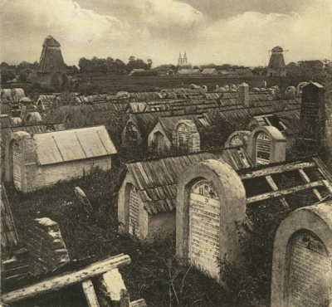
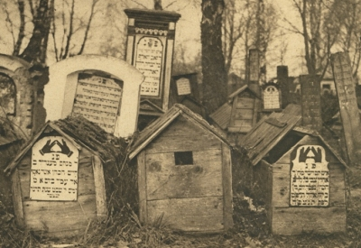
Local architecture reflected in designs of tombs/keverot: even as design offers protection from animals, elements

Slide 30
Iraq and Chalkias, Greece

Slide 31
Beit Chayim – house of the living

Slide 32
Work of the dead: comfort the living
3 R’s
Resurrection
Reincarnation
Redemption
Immediate burial necessary to ensure journey can begin
Belief and action continually reinforced and integrated
Continuity of practices through communal recognition
Forgive the living; enable their eventual atonement
Intervene before God through angels
Dead are sentient, have needs
They are loyal to bonds on earth
Dead ‘mourner’ must be comforted
May punish living for failing to properly give them respect

Slide 33
Work of living: duty to the dead
The living seek merit for souls of the dead through religious acts
Performance of mitzvot – flesh is indispensable to do so
Duty to honour dignity of the dead
Mourners ‘mirror’ the experience of the dead: now we cover our mirrors.
Honour of dead required protection from those still living
Death as a levelling experience
Associations of death with atonement
“Those who die are atoned by their death” Mekhilta
Mourner ‘mirrors’ experience of their dead through death rituals

Slide 34
So many homes….

Slide 35
From Vilna to Penang, Malasia

Slide 36
Continued evolution of rituals in response to history
Continued exile/deaths
Political, economic, social instability
Mandated exiles and dispersion of Jews
Attacks on Jewish communities, forced conversions
Expulsion of Jews from Spain and Portugal
Communal response to communal history
Viduii
Taharah
Kaddish
Mishnah – neshamah
Tzedakah saves from death
Shomrim, recitation of Tehillim

Slide 37
Jews brought burial practices to New World – Lipton: Cree and many other Indigenous peoples used burial houses

Slide 38
Lipton, Saskatchewan

Slide 39
Similar: Russian Orthodox/Athabaskan and Cree spirit houses

Slide 40
Generations of intercession – with angels

Slide 41
Changing times: Enlightenment
Detachment of rites from belief
Increased individuation
Secular subjects
Science, medicine influences practices/beliefs
Increased interaction with gentiles
Secularization and assimilation
Enlightenment = new responses
Haskalah: secular, maskalim
Hasidim: mysticism, pietistic
Political and social emancipation
Transition of customs
Enormous generalized upheaval in Jewish world

Slide 42
What is death? Life?
Change in thinking about afterlife
Moses Mendelssohn defended idea of immortality of soul
Others disavowed traditional doctrines of resurrection and reincarnation
Changes in belief led to changes in behaviour
Gentile standards begin to be implemented and absorbed
Definition of death
Pre-modern definitions challenged
Pressure from modernists to replace
Medical doctors believed some aspect of life might continue after cessation of breath
Significant political rift
Predated rise of Reform movement

Slide 43
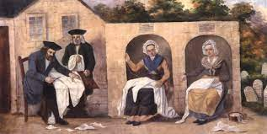
Chevra Kadisha – Prague, 1772

Slide 44
Detachment from, and yet continuity of rituals and traditions
Delayed burials
Desire to appear enlightened, modern and avoid ridicule
Greater controls over once very independent Hevra Kadisha
Professionalization around death rituals – funeral homes, morticians
Belief in afterlife beginning to shift towards “death is death”
Who are rituals for?
Rituals and rites now intended to assist mourners in their grief
Once rituals to assist deceased in their posthumous journey
Internalized by individuals and institutions
Shift of some rites, once considered momentous, now barely a memory

Slide 45
Increased emphasis on this life only
Revelation > Reason
Attempt to harmonize religion within realm of reason
Denied existence of afterlife
Silence regarding resurrection of body
Emerging Reform denomination
All things scientific, including history: Wissenschaft: “Science of Judaism”
Beliefs shift – and of necessity so do practices
“Rend your hearts not your garments” Stein
“Time to abrogate barbaric customs” Geiger
Emphasis on this world, not next
Reason over revelation
Increasing secularization

Slide 46
Pre and post modernity: Changes in belief = changes in practice

Slide 47
Change is the new black
More changes
Coffins replace board lined graves
Ornate styles of coffins
Prohibition from wearing torn clothing to synagogue
Prohibition of mourners leading services
Professionalization of leadership
Mourning period abbreviated
Assimilation and acculturation
Internalization of religious and aesthetic norms of broader European culture
Assimilation created innovations in practices
New standards of conduct
Transitions made over decades
Order and propriety desired

Slide 48
Tautology of Death rituals: Diminishment of belief = diminishment of practice = diminishment of belief

Slide 49
D. Kraemer: Theology of death/Afterlife
Eternal cycle of life now in question
Life-death-renewed life
Death is not/death
End of life not seen as catastrophic
Who is in control? God? Us?
No theology and no magic.
Loss of belief has transformed modern theology
Inability of many moderns to believe in afterlife
Death as extinction of life
Distances us from our ancestors
Loneliness of death

Slide 50
Never mind magic, faith now abrogated from rituals and practice
Practice disengaged from faith
Ritualized burial, often minimal, without grounding in faith
Customs and rituals virtually always seen as designed for comfort of mourner
Sense of relationship between dead and living psychologized
Theological despair/indifference
Prior loss of belief in death-as-life and life after death creates
How to make sense of death
Rationalized Judaism devoid
Death = nothingness
Modern Jews: Frozen without faith options

Slide 51
Abraham Geiger meets Sigmund Freud

Slide 52
Freud wins
Abraham Geiger – 1830’s
Praised Judaism for emphasis on living in this world
Isolated resurrection of dead from immortality of soul (Greek)
Unlike Christianity: does not emphasize eternal dimension
Mourning now seen as necessary consolation for the soul of the bereaved.
A once symbiotic relationship between living and dead is no longer acknowledged.
Communal rituals have lost their magic; now the realm of personal psychology

Slide 53
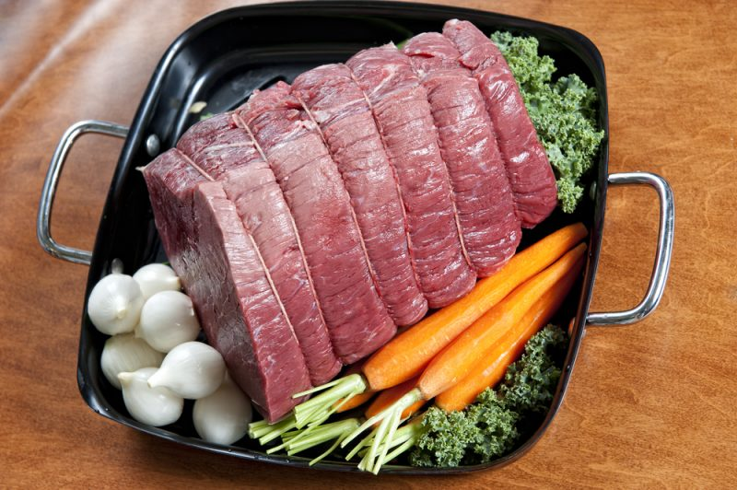

Slide 54
Superstitions give way to parks, beauty, science and order: Pere Lachaise and Mount Auburn

Slide 55
What now? Magic or ritual? Does it matter?
Are these rituals binding us to our dead through magical thinking? Do we hold to them, however minimally, because they bind us one to the other through mutual recognition, thus providing mutual comfort?
Ritualized magic provides an awareness we don’t have all the answers, we have limits to our capacities. What do we need?

Slide 56
Names or bones? Icons of memory are always needed

Slide 57
Israel today: Finding a parking space in underground and parking garages

